Slide 1
RH077 Form Analysis Results
Preliminary data – March/April 22

Slide 2
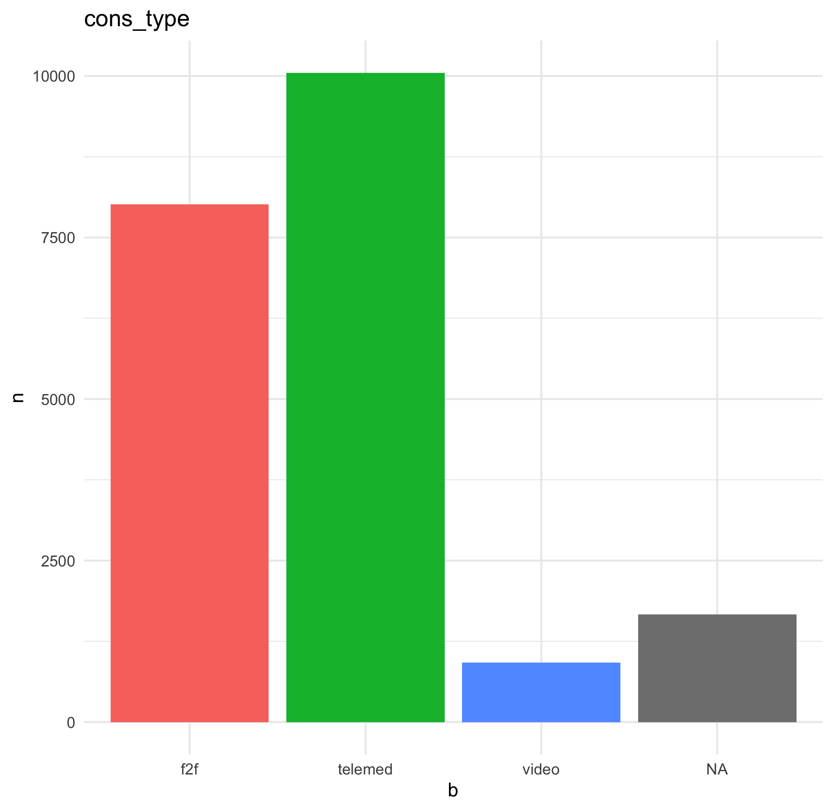
Overview
The complete RH077 form spreadsheet has 20647 entries at the time of analysis (March 22), across at least 16 different clinic types/diagnoses
The date range is: 2020-09-02 to 2022-01-17
Consultation types:
Type | n | %
Face to Face | 8016 | 38.82
Telemedicine | 10046 | 48.65
Video | 921 | 4.460
NA (not recorded) | 1664 | 8.06

Slide 3
‘Virtual’ vs Face-to-Face
For virtual (video or telephone) consultations, how many were felt to have “avoided” a face-to-face clinic appointment¹
Avoided F2F? | n | %
FALSE | 848 | 4.11
TRUE | 8525 | 41.29
¹ Not all respondents answered this question

Slide 4
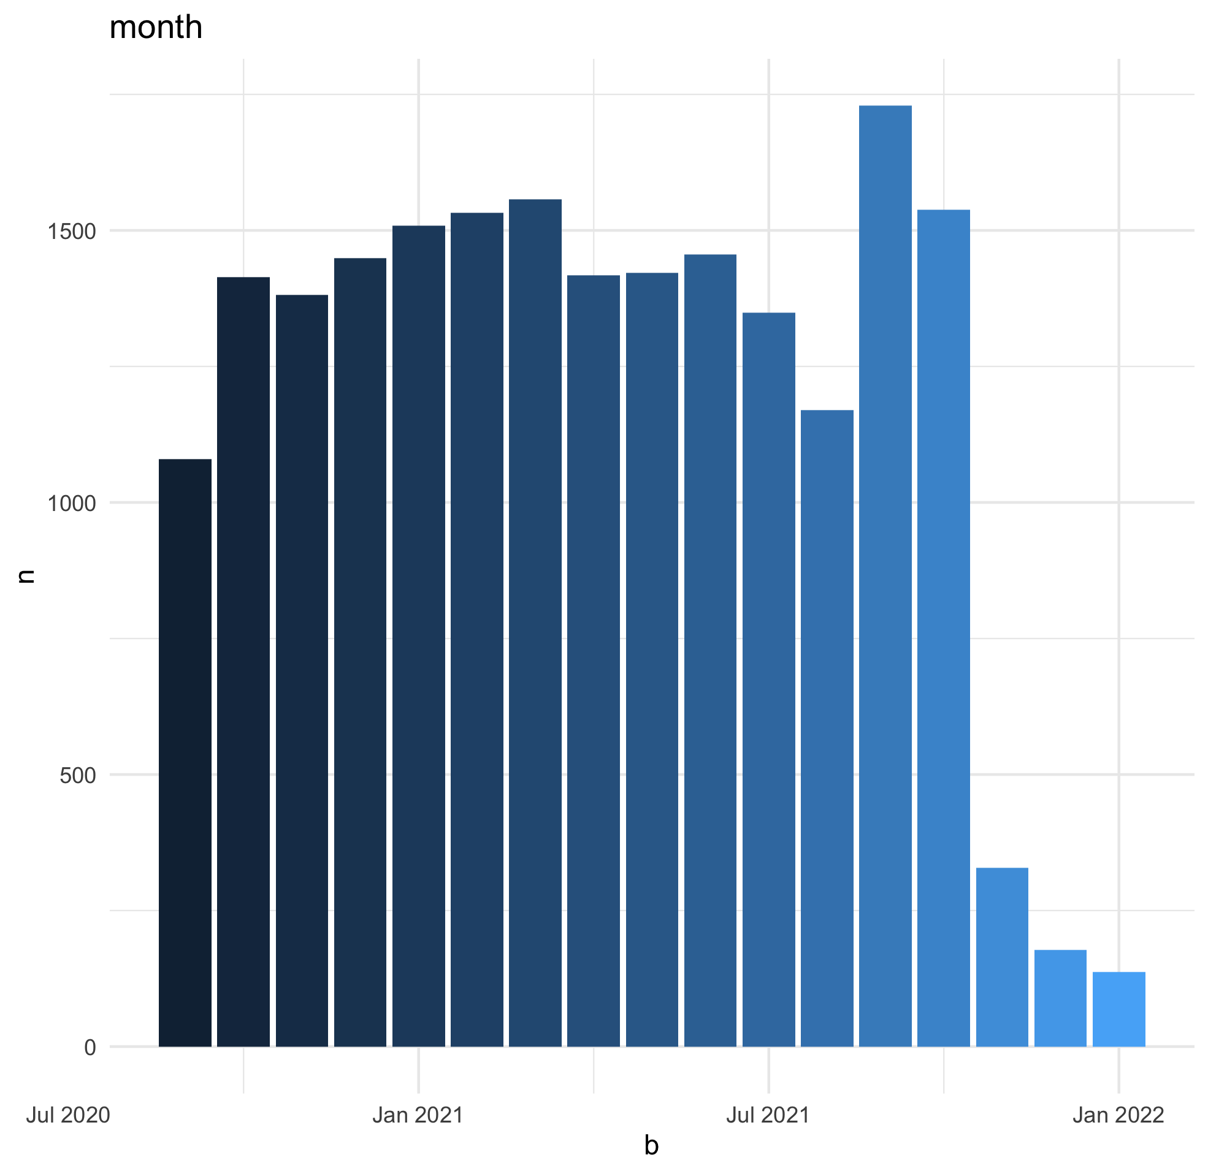
Number seen per month
Month | n | %
Sep-20 | 1080 | 5.23
Oct-20 | 1414 | 6.85
Nov-20 | 1382 | 6.69
Dec-20 | 1449 | 7.02
Jan-21 | 1509 | 7.31
Feb-21 | 1532 | 7.42
Mar-21 | 1557 | 7.54
Apr-21 | 1417 | 6.86
May-21 | 1422 | 6.89
Jun-21 | 1456 | 7.05
Jul-21 | 1349 | 6.53
Aug-21 | 1170 | 5.67
Sep-21 | 1729 | 8.37
Oct-21 | 1538 | 7.45
Nov-21 | 328 | 1.59
Dec-21 | 178 | 0.86
Jan-22 | 137 | 0.66

Slide 5
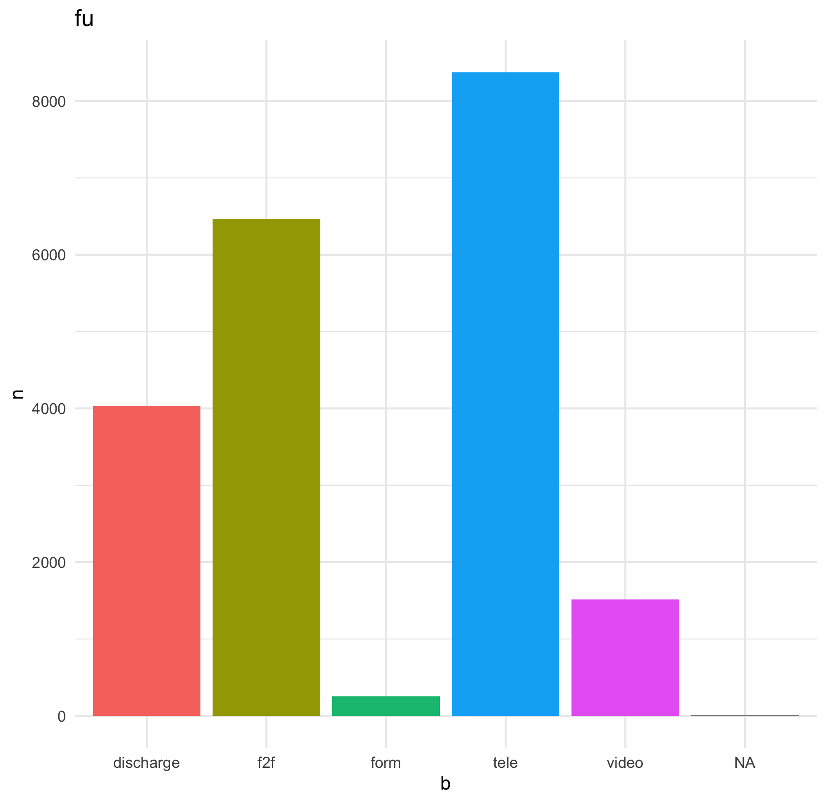
Follow Up I – Outcome
What type of follow up was allocated for each patient
Type | n | %
Discharged | 4031 | 19.52
Face to Face | 6465 | 31.31
Form (remote management) | 252 | 1.22
Telemedicine | 8372 | 40.55
Video | 1516 | 7.34
NA (not recorded) | 11 | 0.05

Slide 6
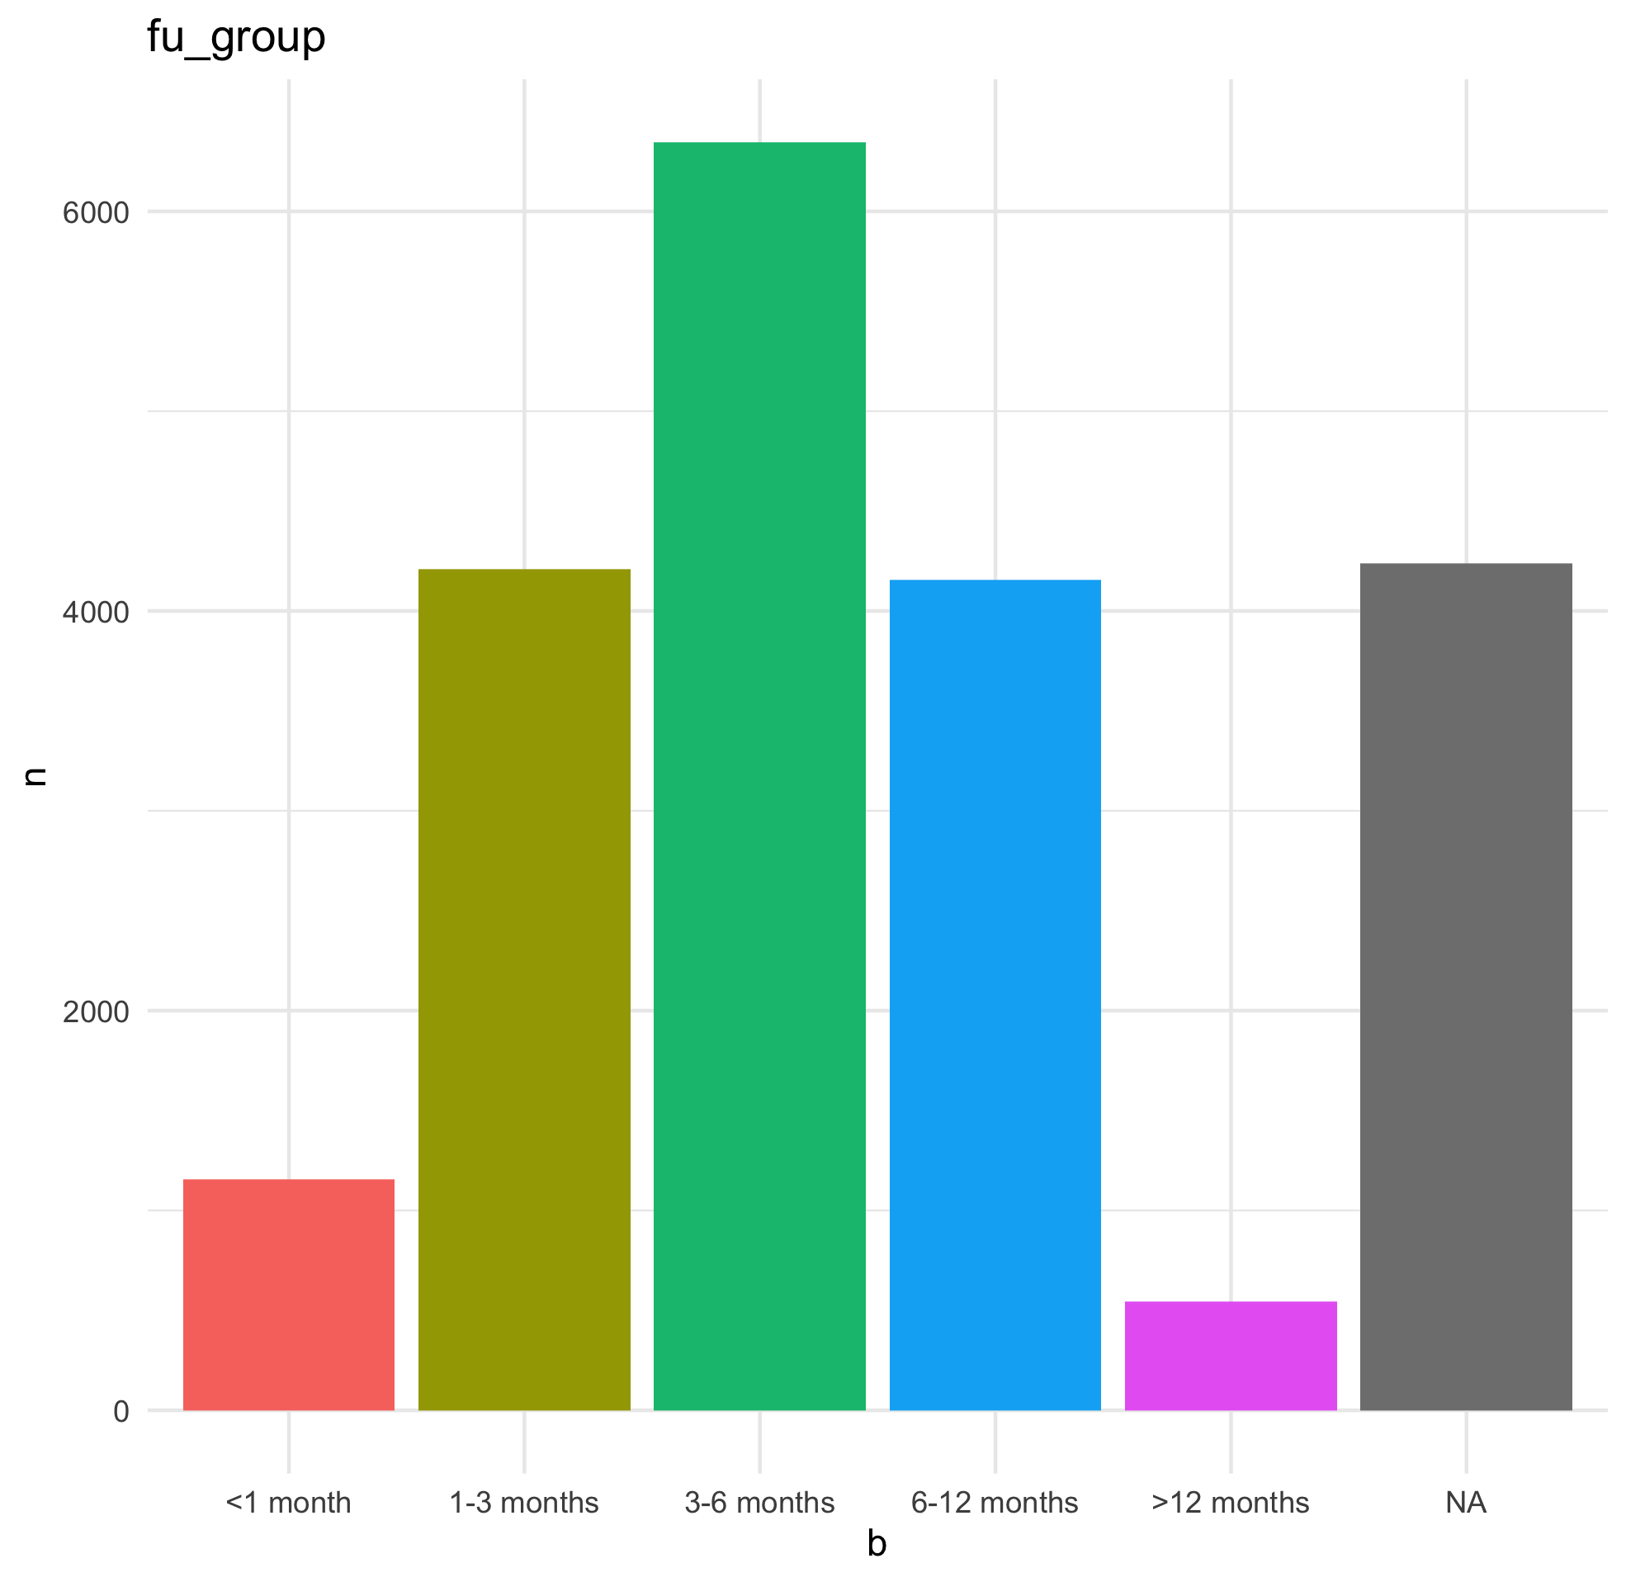
Follow Up II - Duration
How soon patients were followed up¹
Interval | n | %
<1 month | 1154 | 5.59
1-3 months | 4209 | 20.39
3-6 months | 6344 | 30.73
6-12 months | 4156 | 20.13
>12 months | 544 | 2.63
NA | 4240 | 20.54
¹ Urgent follow up classified as <1 month. ”Next available” has been excluded here

Slide 7
Management
How many new patients seen were stared on treatment?
Started on Treatment? | n | %
FALSE | 2894 | 57.80
TRUE | 228 | 4.55
NA (not recorded) | 1885 | 37.65

Slide 8
GRAPHS

Slide 9
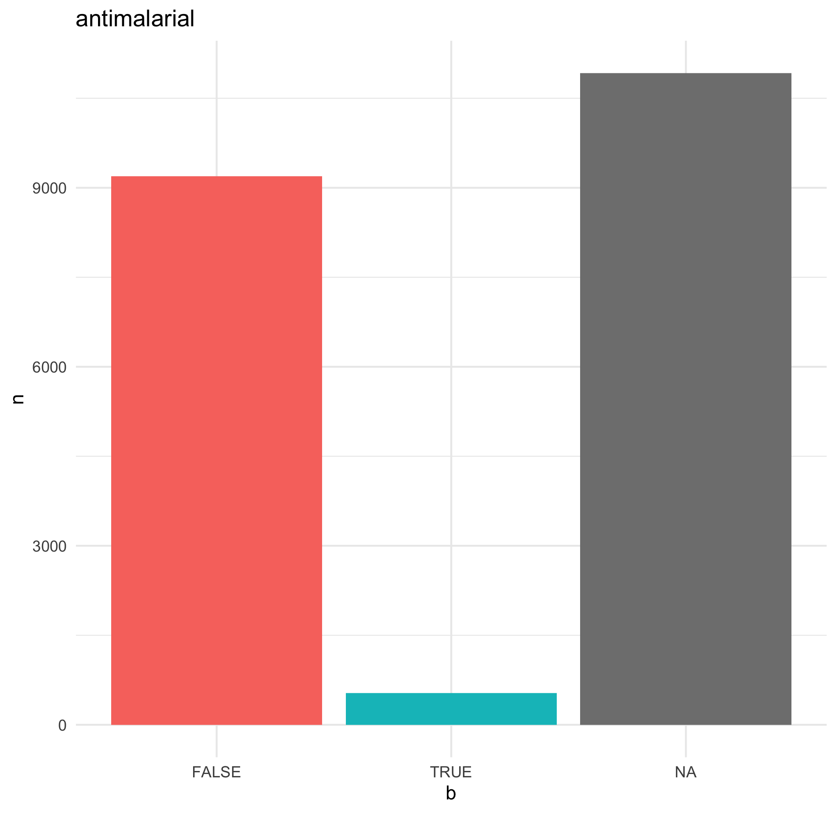
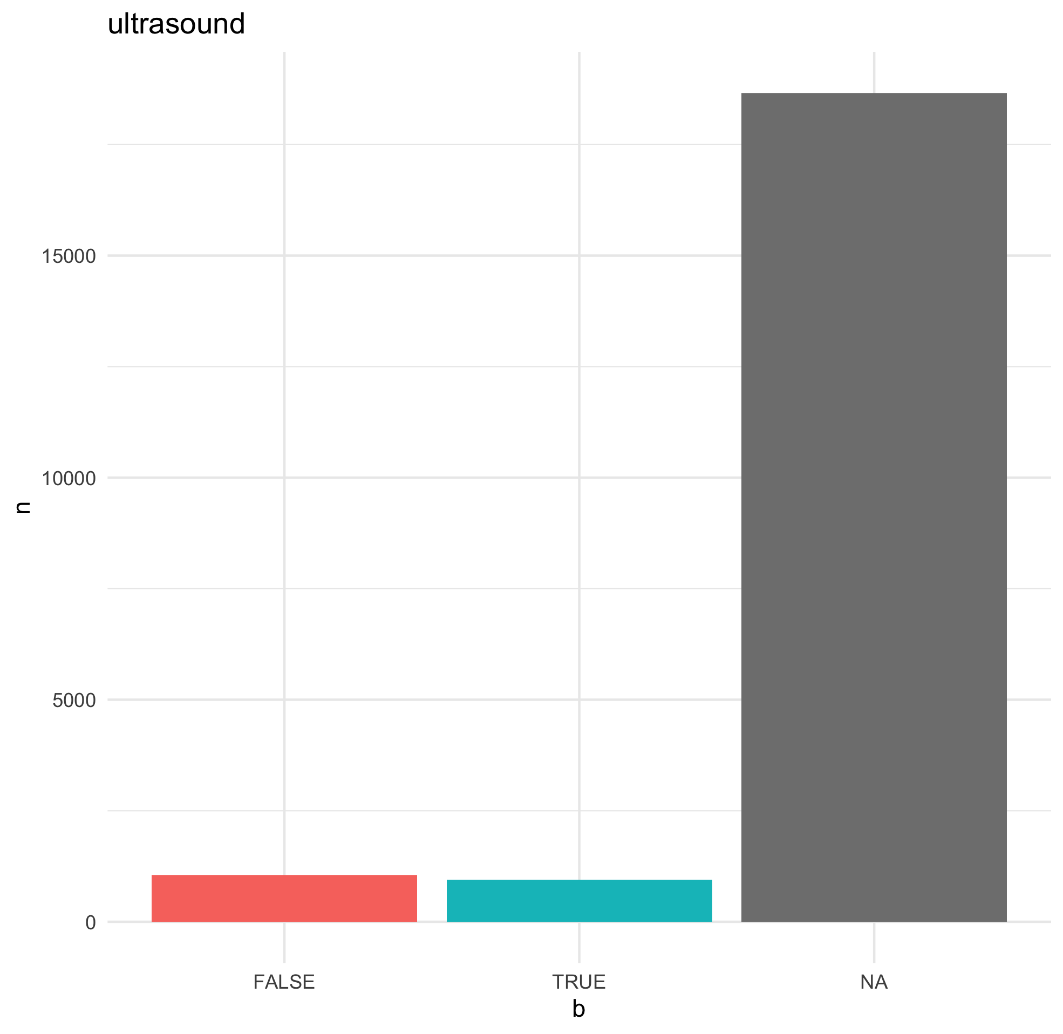

Slide 10
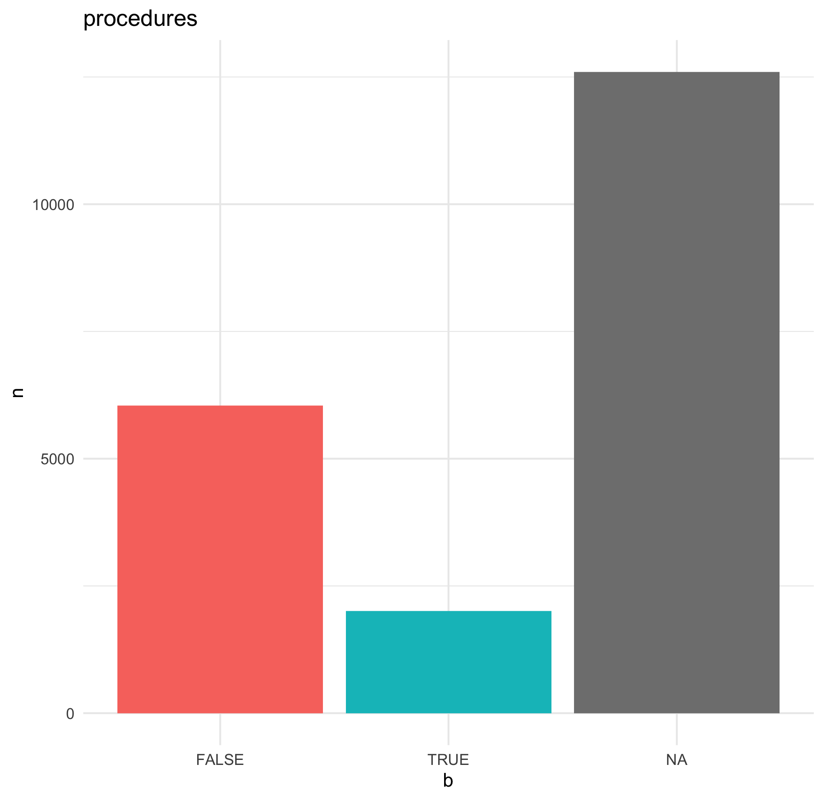

Slide 11
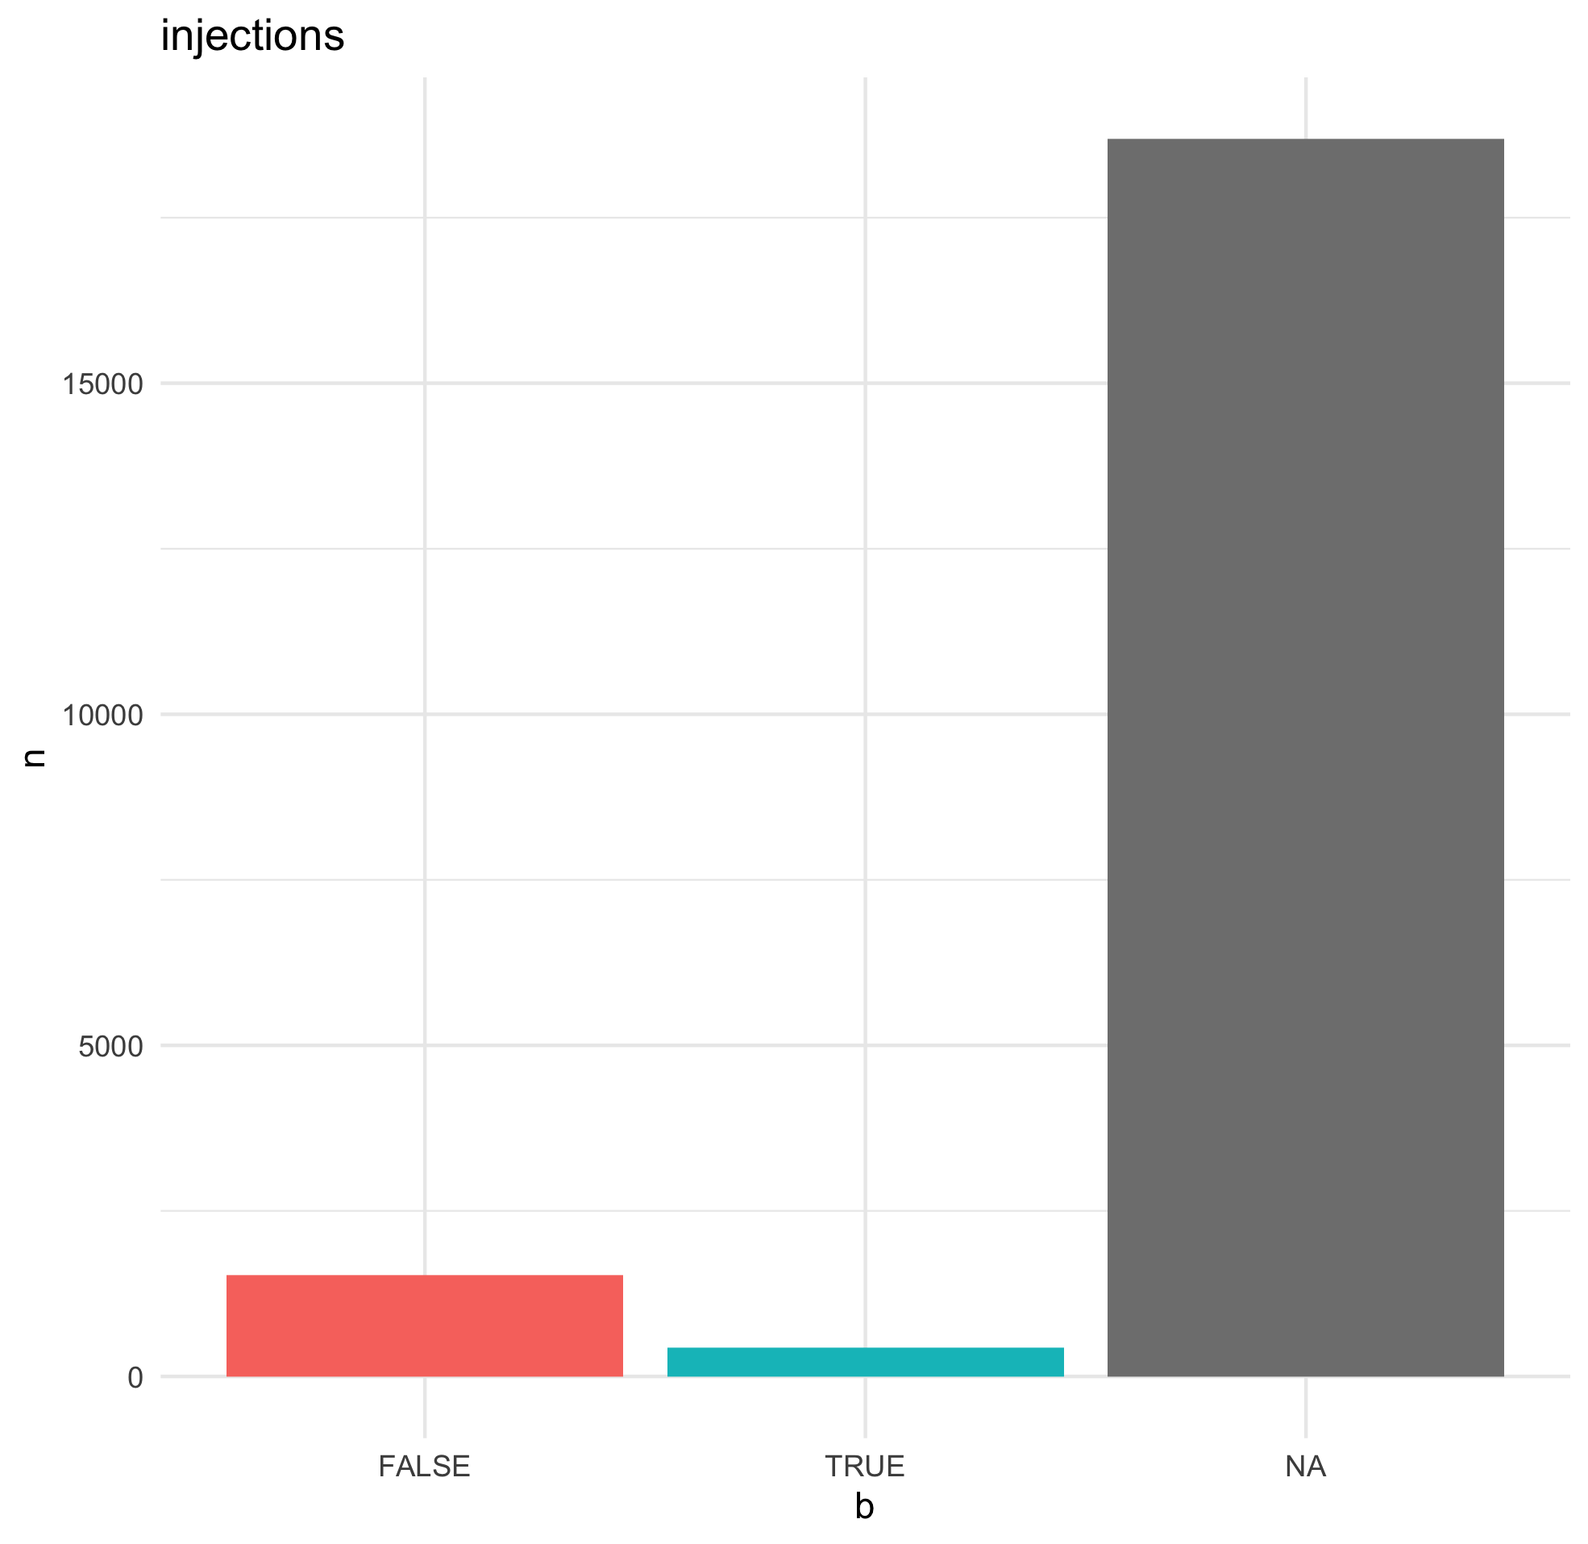
MONTH

Slide 12
FOLLOW UP

Slide 13
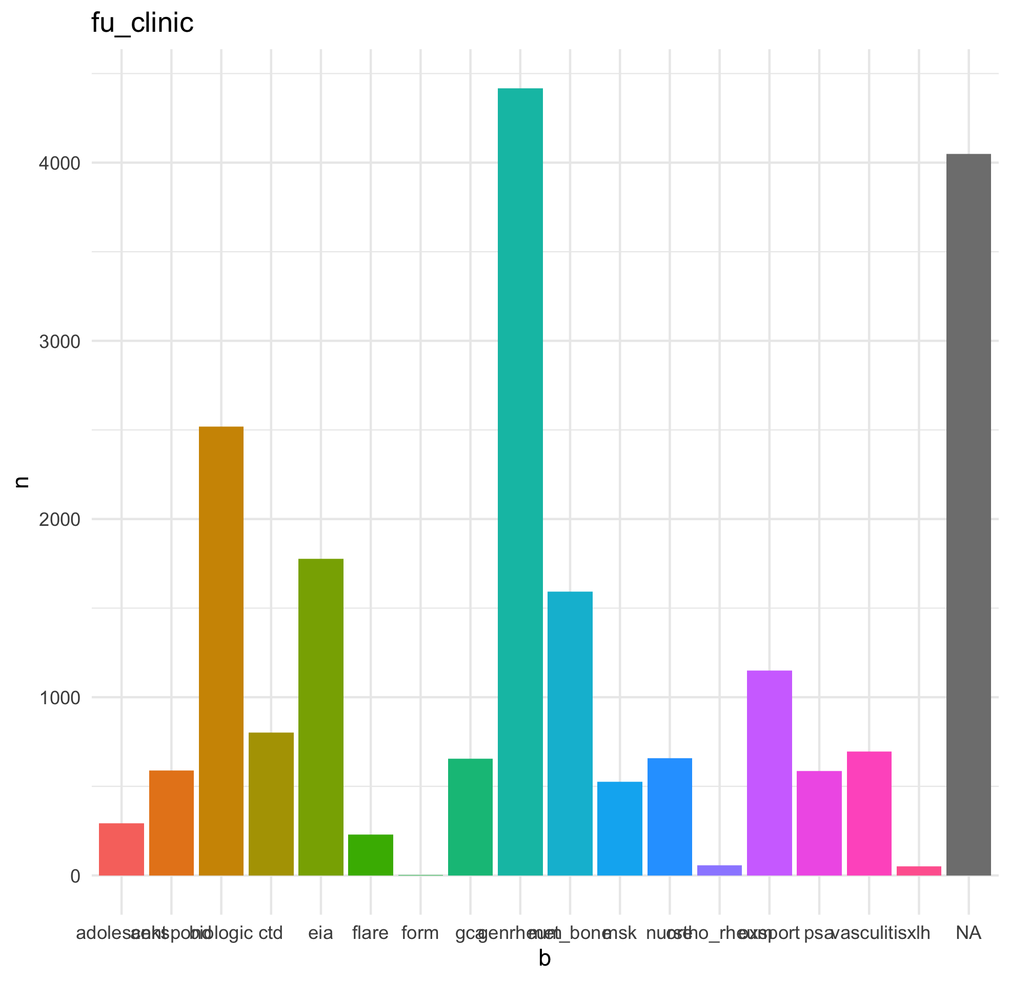
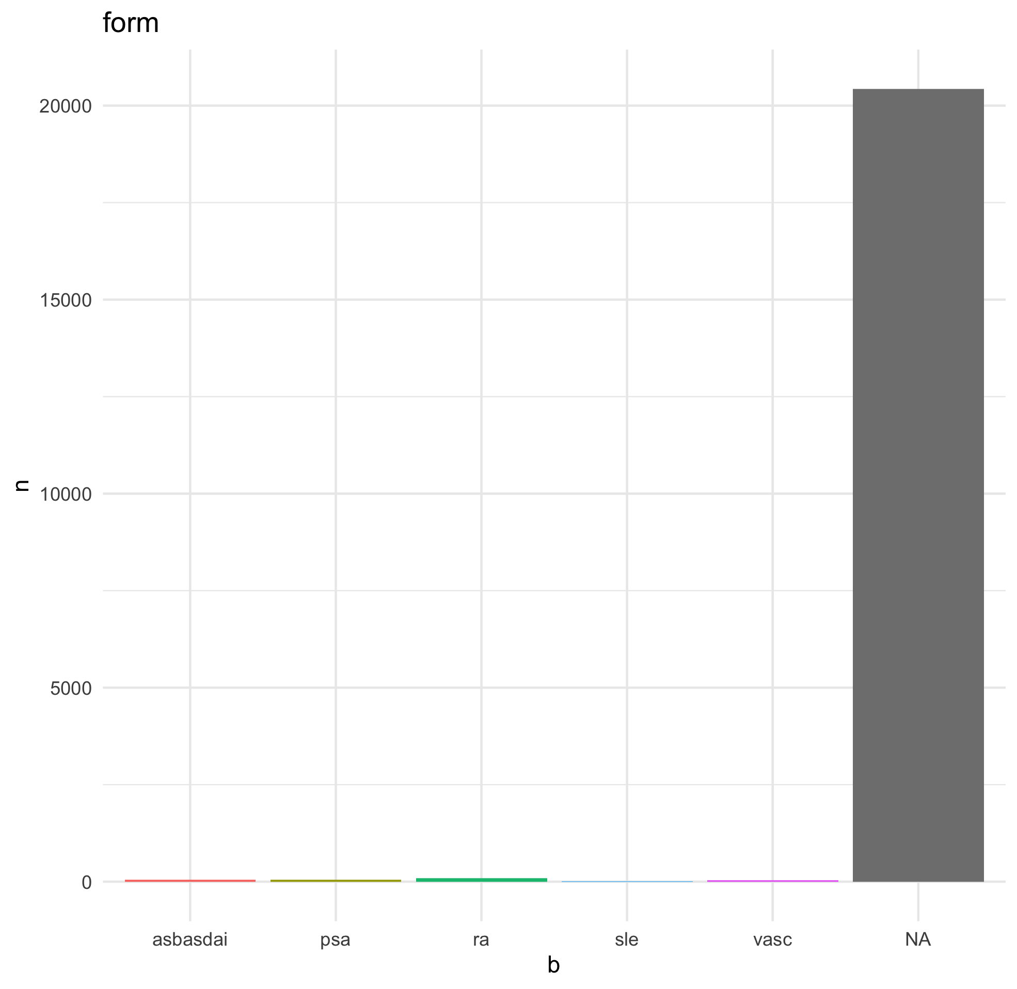
FOLLOW UP CLINIC

Slide 14
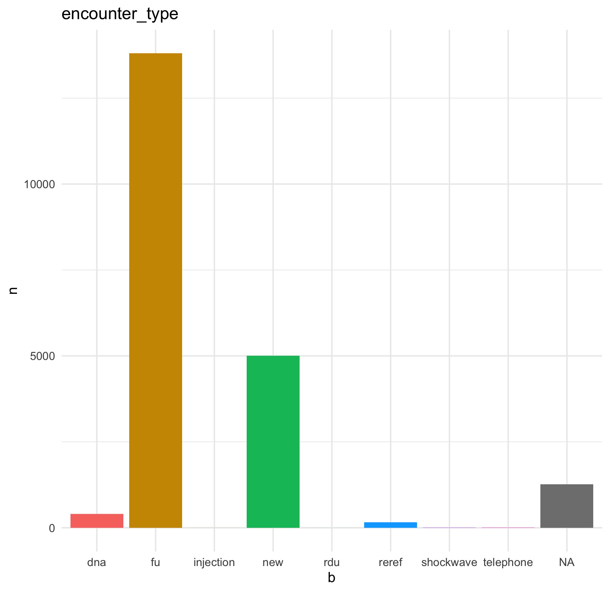
ENCOUNTERS – TYPE AND MODALITY

Slide 15
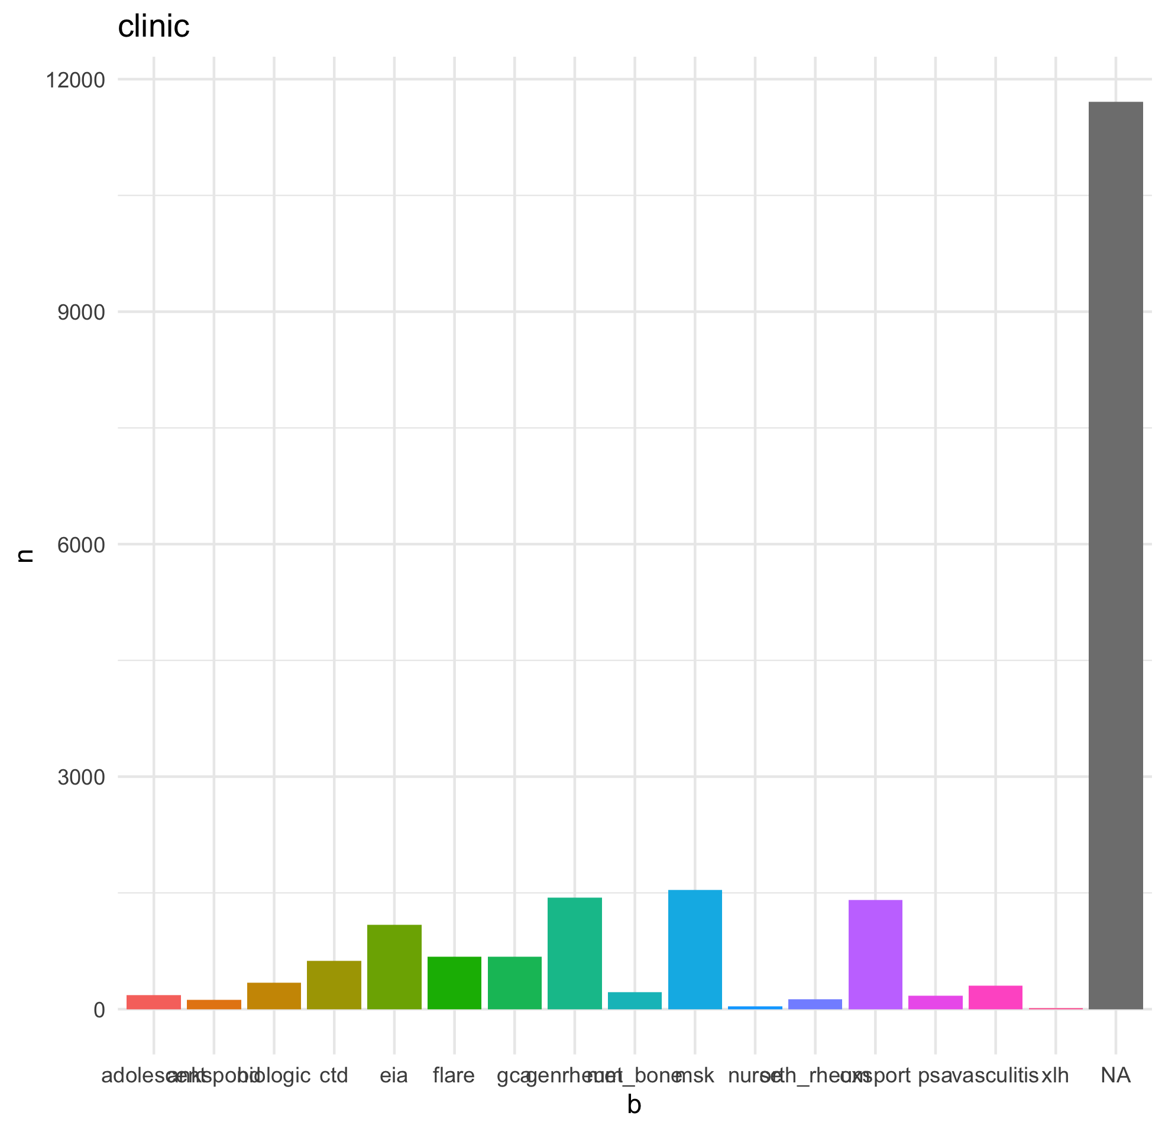
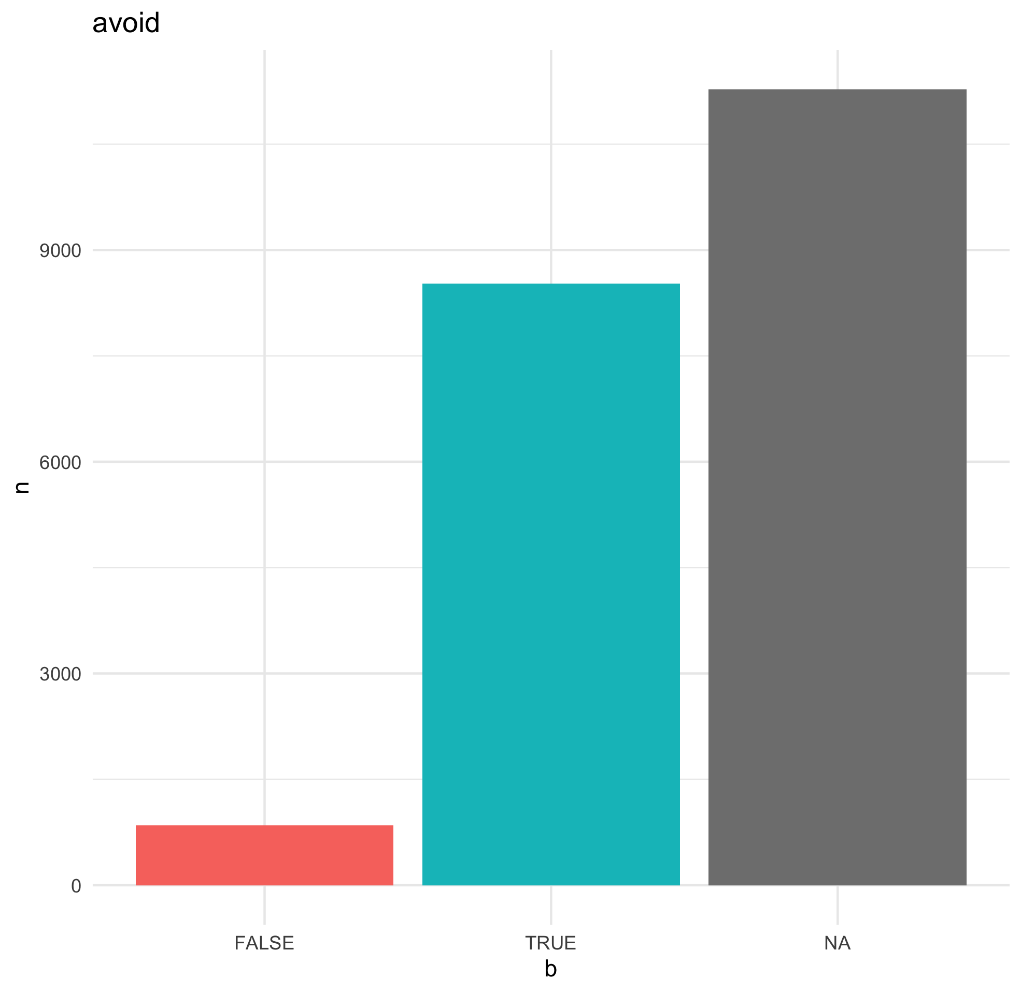
Clinic type - ?avoid

Slide 16
